Slide 1
CIT-Banoqabil
All the things I’ve learned in this course
Bisma Shakil
459798

Slide 2
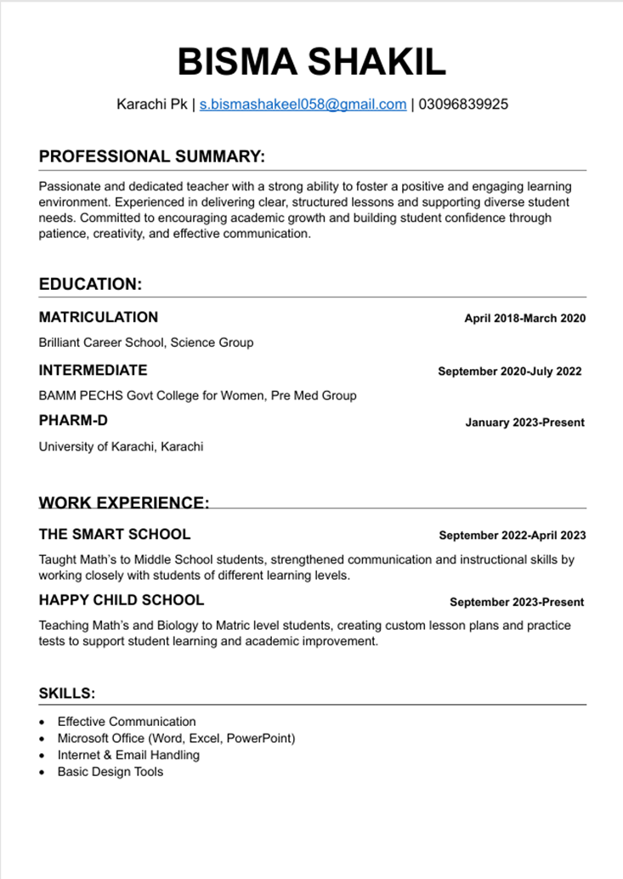
Microsoft Word-creating Resume
I created my resume using Microsoft Word, applying skills learned in my course to create a professional document. I utilized Headers, bullet points, and consistent formatting tools to structure my education and work experience clearly. Learning to use tables and line breaks effectively allowed me to design a clean layout that highlights my key skills and qualifications, presenting a polished and professional image to employers.

Slide 3
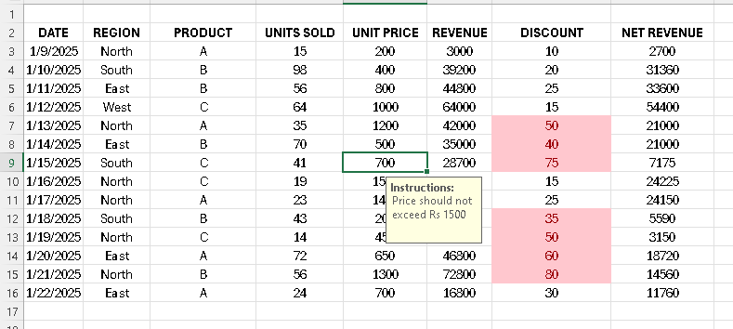
Microsoft Excel-Data Validation & Conditional formatting
I created this structured sales report by applying the Excel skills learned in my course. I built the table by inputting raw data and used formulas to automatically calculate the Revenue (=UNITS SOLD * UNIT PRICE) and Net Revenue (=REVENUE - DISCOUNT). To ensure data accuracy, I used Data Validation to create dropdown lists for 'Region' and 'Product' fields, preventing spelling errors and maintaining consistency. I then applied Conditional Formatting to the 'Net Revenue' column to visually highlight top-performing sales, using color scales to instantly identify high and low values. Finally, I formatted the sheet with borders, bold headers, and number formatting to make it professional and easy to read, turning raw data into clear, actionable information.

Slide 4
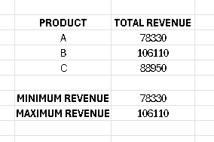
Microsoft Excel-sum,min,max values
This summary table was created using key Excel functions learned in the course. I used the SUM function to calculate the TOTAL REVENUE for each product (A, B, and C), which automatically pulls and sums values from the larger sales dataset based on product criteria. To determine the overall MINIMUM REVENUE and MAXIMUM REVENUE across all products, I applied the MIN and MAX functions to the total revenue values. This approach allows for clear and accurate analysis of product performance without the need for manual calculations.

Slide 5
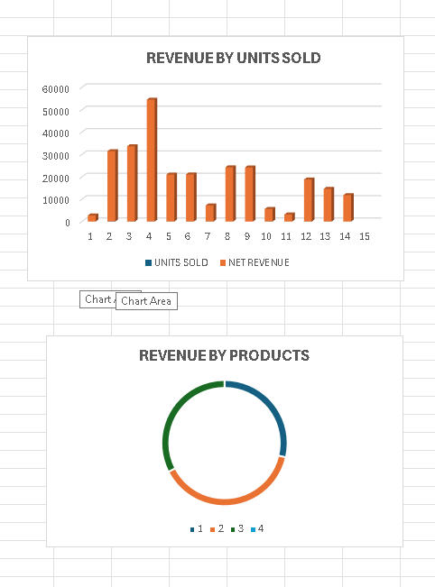
Microsoft Excel-Plotting graphs
created these professional charts by applying the data visualization techniques learned in my Microsoft Excel course. Using the sales data, I first organized the information and then used the Insert Chart feature to build a visual representation. I created a Scatter Plot or Line Chart to analyze the relationship between "Units Sold" and "Revenue," which helps in identifying sales trends. I also generated a Bar or Pie Chart for "Revenue by Products" to compare the performance of different items easily. Finally, I used the Chart Tools to add titles, format colors, and insert labels, making the data clear and visually impactful for a presentation.

Slide 6
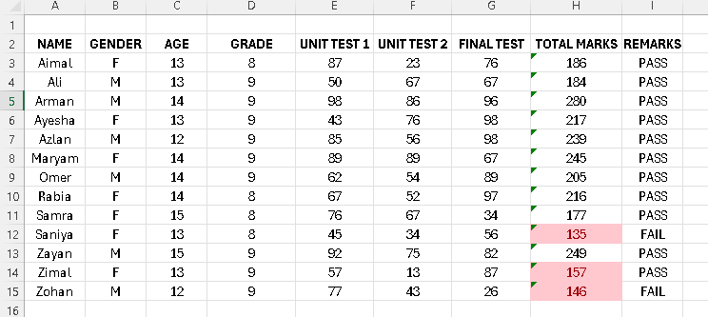
Microsoft Excel-If/else statement
I created this organized student record sheet by applying the data management skills learned in my Microsoft Excel course. I built the table structure and used the SUM function to automatically calculate the TOTAL MARKS for each student by adding their Unit Test 1, Unit Test 2, and Final Test scores. To generate the REMARKS column (PASS/FAIL), I used the IF function to set a passing criteria (e.g., =IF(Total_Marks>=150, "PASS", "FAIL")), allowing Excel to automatically determine each student's status based on their total score. This project helped me learn how to use formulas for quick calculations and logical outcomes, making data analysis efficient and error-free.

Slide 7
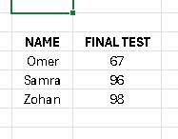
Microsoft Excel-Vlookup values
I applied the powerful VLOOKUP function learned in my Microsoft Excel course to efficiently retrieve specific student information from a larger dataset. Using this table as a reference, I practiced searching for a student's NAME in a master gradebook and automatically returning their corresponding FINAL TEST score. This helped me understand how to use the formula's parameters: looking up a value, defining the table array, specifying the column index number, and using FALSE for an exact match. Mastering VLOOKUP allows me to quickly extract specific data from large tables without manual searching, significantly improving my data management efficiency.

Slide 8
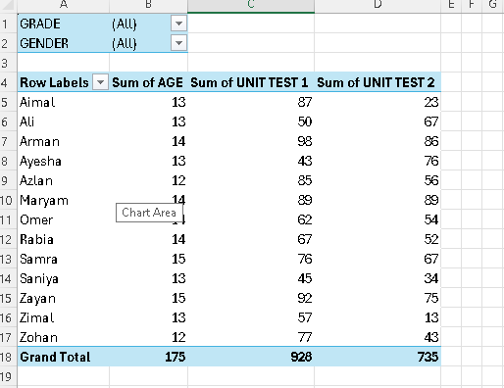
Microsoft Excel-Pivot Tables
Based on my Excel course, I learned to create this Pivot Table to efficiently summarize and analyze student data. It automatically calculates totals for Age, Unit Test 1, and Unit Test 2, allowing me to quickly review and compare performance across all students.

